Slide 1
BANK DATABASE SYSTEM
Shivani Chavan – 001582611
Snehal Chavan – 001095864
Abbas Furniturewala – 002193272
Kashish Santani -

Slide 2
OBJECTIVE
To create a database which helps a bank/financial institution manage their day to day operations easily and efficiently.
Maintain Data integrity and accuracy
Manage data of Employees, Customers and Transactions
Creating an easily accessible data model for storing and retrieving data

Slide 3
HIGHER LEVEL DESIGN

Slide 4
ER DIAGRAM

Slide 5
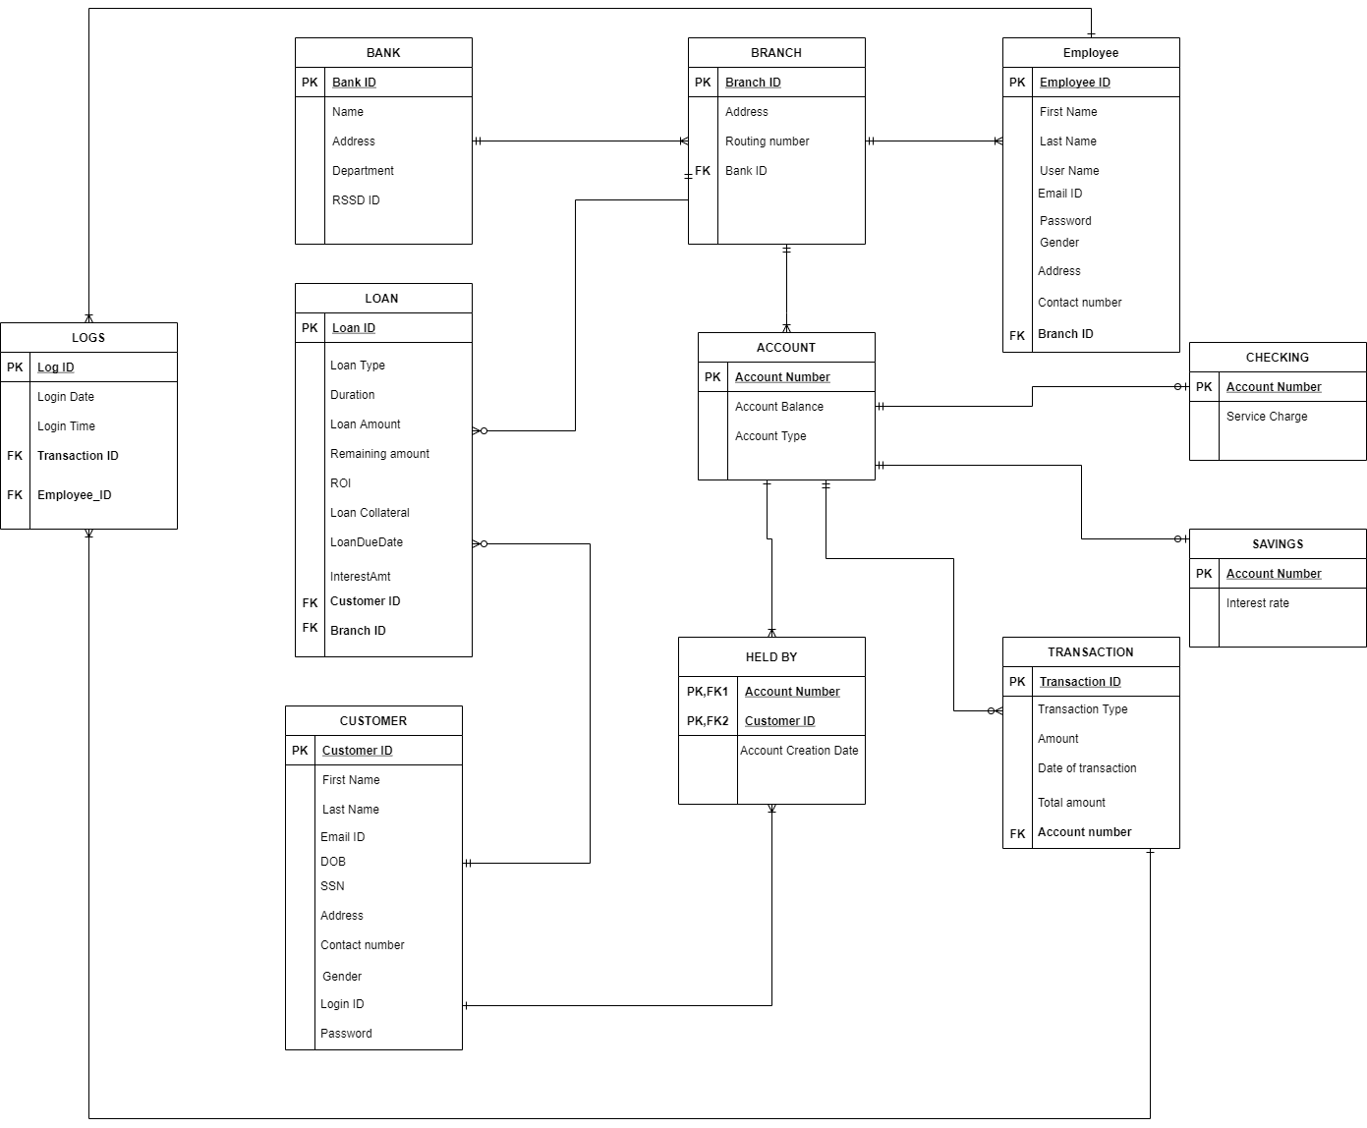

Slide 6
DDL SCRIPTS
CREATE DATABASE BANKDBMS;
GO
CREATE TABLE BANK
(
BankID int not null,
Name varchar(30),
[Address] varchar(50),
Department varchar(15),
RSSDID varchar(15),
CONSTRAINT Bank_PK primary key (BankID)
);
CREATE TABLE BRANCH
(
BranchID int not null,
Address varchar(50),
RoutingNo bigint,
BankID int not null
CONSTRAINT Branch_PK primary key (BranchID),
CONSTRAINT Branch_FK foreign key (BankID) references BANK(BankID)
);

Slide 7
CREATE TABLE EMPLOYEE
(
EmployeeID int not null,
FirstName nvarchar(15),
LastName nvarchar(15),
UserName varchar(25),
EmailID varchar(50),
[password] varchar(400),
Gender char(1),
Address varchar(50),
ContactNumber bigint,
BranchID int not null,
CONSTRAINT Employee_PK primary key (EmployeeID),
CONSTRAINT Employee_FK foreign key (BranchID) references Branch(BranchID)
);
CREATE TABLE Customer
(
CustomerID int not null,
FirstName nvarchar(15),
LastName nvarchar(15),
EmailID char(50),
DOB date,
SSN int,
Address varchar(50),
ContactNumber bigint,
Gender char(1),
LoginID varchar(15) not null,
[password] varchar(400),
CONSTRAINT Customer_PK primary key (CustomerID),
);

Slide 8
CREATE TABLE ACCOUNT
(
AccountNumber bigint not null,
AccountBalance money,
AccountType char(20) CONSTRAINT
AccountType_CHK CHECK (AccountType IN ('Savings','Checking')),
CONSTRAINT Account_PK primary key (AccountNumber),
);
CREATE TABLE LOAN
(
LoanID int,
LoanType char(20) CONSTRAINT
LoanType_CHK CHECK (LoanType IN ('Personal','Business','Education','Home')),---noof chars
Duration int,
LoanDueDate date,
InterestAmt decimal,
LoanAmount money,
RemainingAmount money,
ROI decimal,
LoanCollateral char(50),
CustomerID int not null,
BranchID int not null,
CONSTRAINT Loan_PK primary key (LoanID),
CONSTRAINT Loan_FK1 foreign key (CustomerID) references Customer(CustomerID),
CONSTRAINT Loan_FK2 foreign key (BranchID) references Branch(BranchID)
);

Slide 9
CREATE TABLE LOGS
(
LogID int not null,
LoginDate date,
LoginTime time,
TransactionID int,
EmployeeID int not null,
CONSTRAINT Logs_PK primary key (LogID),
CONSTRAINT Logs_FK1 foreign key (EmployeeID) references Employee(EmployeeID),
CONSTRAINT Logs_FK2 foreign key (TransactionID) references [Transaction](TransactionID)
);
CREATE TABLE HELD_BY
(
AccountNumber bigint not null,
CustomerID int not null,
Account_Creation_Date date
CONSTRAINT HELDBY_FK1 foreign key (AccountNumber) references Account(AccountNumber),
CONSTRAINT HELDBY_FK2 foreign key (CustomerID) references Customer(CustomerID)
);
CREATE TABLE SAVINGS(
AccountNumber bigint not null,
Interest_rate decimal(2,2),
CONSTRAINT SAVING_PK PRIMARY KEY(AccountNumber)
);

Slide 10
CREATE TABLE [TRANSACTION]
(
TransactionID INT NOT NULL IDENTITY(1122,1),
TransactionType CHAR(10) NOT NULL CONSTRAINT
TransactionType_CHK CHECK (TransactionType IN ('Credit','Debit')),
Amount SMALLMONEY,
DateOfTransaction date,
AccountNumber bigint not null,
CONSTRAINT TransactionID_pk PRIMARY KEY(TransactionID),
CONSTRAINT AccountNumber_FK FOREIGN KEY(AccountNumber) references Account(AccountNumber)
);
CREATE TABLE CHECKING (
AccountNumber bigint not null,
Service_Charge decimal(2,2),
CONSTRAINT CHECKING_PK PRIMARY KEY(AccountNumber)
);

Slide 11
COMPUTED COLUMNS
-------------------------------------computed column to find age of customer
ALTER TABLE Customer ADD CurrentAge AS DATEDIFF(YEAR, DOB, GETDATE())
SELECT * FROM Customer

Slide 12
NON_CLUSTERED INDEX
--------------Non-clustered index
CREATE NONCLUSTERED INDEX NonClusteredIndex_Transaction
ON [Transaction] (DateOfTransaction)
WITH (ONLINE = ON , FILLFACTOR=90)
SELECT *
FROM [TRANSACTION]
WHERE DateOfTransaction = '2021-11-20' AND Amount> 500

Slide 13
ENCRYPTION
------------------------------------------------------Encryption
USE BANKDBMS
GO
-- Create database Key
CREATE MASTER KEY ENCRYPTION BY
PASSWORD = 'Password@2021';
-- Create self signed certificate
CREATE CERTIFICATE SSN_enc
WITH SUBJECT = 'Customer SSN';
GO
USE BANKDBMS
GO
-- Create symmetric Key
CREATE SYMMETRIC KEY SSN_Key
WITH ALGORITHM = AES_256
ENCRYPTION BY CERTIFICATE SSN_enc;
GO

Slide 14
USE BANKDBMS
GO
ALTER TABLE CUSTOMER
ADD SSN_encrypt varbinary(MAX) NULL
GO
-- Populating encrypted data into new column.
USE BANKDBMS
GO
-- Opens the symmetric key for use
OPEN SYMMETRIC KEY SSN_Key
DECRYPTION BY CERTIFICATE SSN_enc;
USE BANKDBMS
GO
UPDATE CUSTOMER SET SSN_encrypt = EncryptByKey(Key_GUID('SSN_Key'),cast(SSN as varchar(10)))
FROM Customer;
GO
-- Closes the symmetric key
CLOSE SYMMETRIC KEY SSN_key;
GO
SELECT * FROM Customer;
USE BANKDBMS;
GO
ALTER TABLE Customer
DROP COLUMN SSN_encrypt;
GO

Slide 15
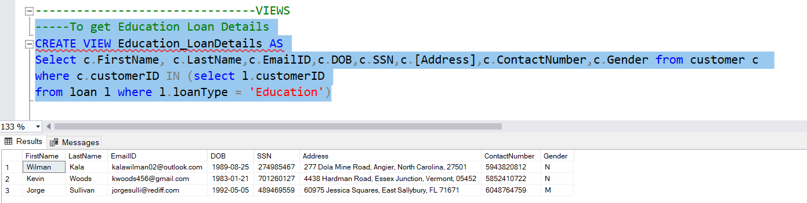
VIEWS
-----To get Education Loan Details
CREATE VIEW Education_LoanDetails AS
Select c.FirstName, c.LastName,c.EmailID,c.DOB,c.SSN,c.[Address],c.ContactNumber,c.Gender from customer c
where c.customerID IN (select l.customerID
from loan l where l.loanType = 'Education')

Slide 16
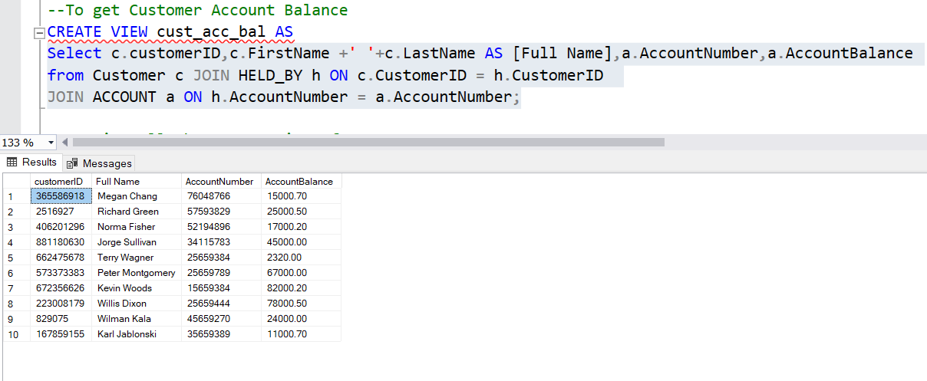
--To get Customer Account Balance
CREATE VIEW cust_acc_bal AS
Select c.customerID,c.FirstName +' '+c.LastName AS [Full Name],a.AccountNumber,a.AccountBalance
from Customer c JOIN HELD_BY h ON c.CustomerID = h.CustomerID
JOIN ACCOUNT a ON h.AccountNumber = a.AccountNumber;

Slide 17
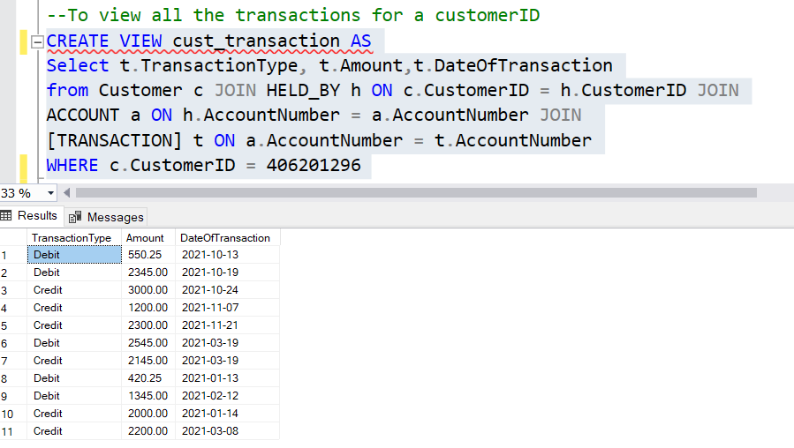
--To view all the transactions for a customerID
CREATE VIEW cust_transaction AS
Select t.TransactionType, t.Amount,t.DateOfTransaction
from Customer c JOIN HELD_BY h ON c.CustomerID = h.CustomerID JOIN
ACCOUNT a ON h.AccountNumber = a.AccountNumber JOIN
[TRANSACTION] t ON a.AccountNumber = t.AccountNumber
WHERE c.CustomerID = 406201296

Slide 18
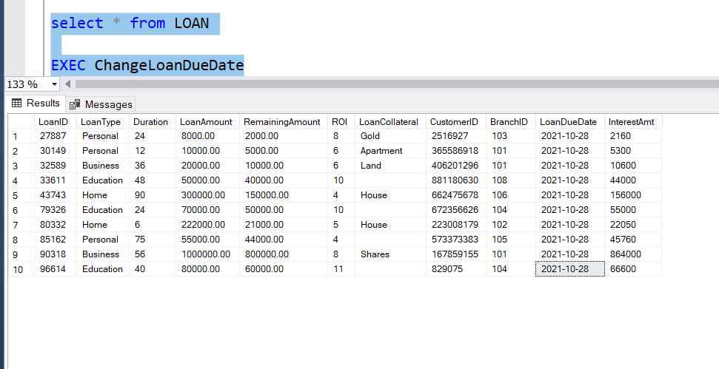
STORED PROCEDURES
------Stored Procedure to Update Loan Due Date dynamically
CREATE PROCEDURE ChangeLoanDueDate
AS
BEGIN
declare @LoanDueDate date
declare @CurrentDate date
SET @CurrentDate = GETDATE()
SELECT @LoanDueDate = LoanDueDate FROM LOAN;
IF @CurrentDate = DATEADD(month, 1,@LoanDueDate)
BEGIN
UPDATE LOAN SET LoanDueDate = DATEADD(month, 1,@LoanDueDate);
END
END

Slide 19
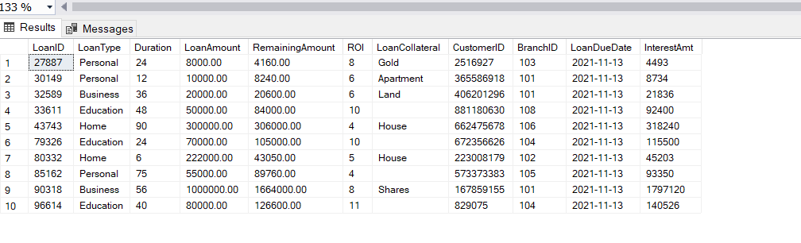
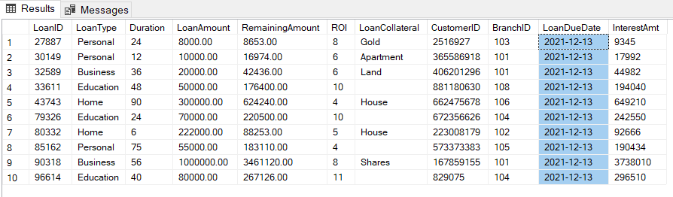
---------------------------------Trigger to Update Loan Amount upon change in Loan Due Date
CREATE TRIGGER LoanAmountUpdate
ON LOAN
FOR UPDATE
AS
BEGIN
IF UPDATE(LoanDueDate)
begin
UPDATE LOAN SET RemainingAmount = RemainingAmount + InterestAmt
end
end

Slide 20
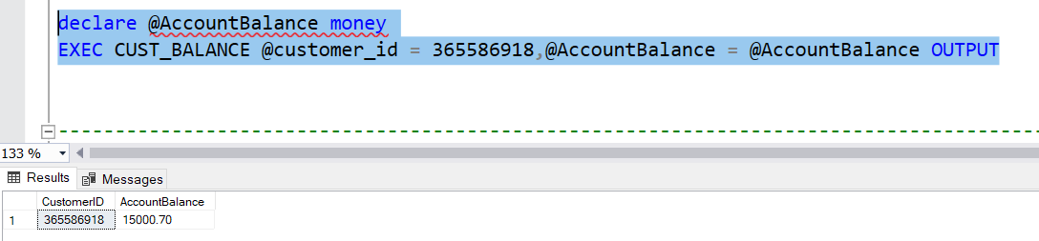
----------Procedure to fetch Customer Account Balance for entered Customer ID
CREATE PROCEDURE CUST_BALANCE(
@customer_id int,
@AccountBalance money OUTPUT
)AS
BEGIN
SELECT c.CustomerID,a.AccountBalance
FROM Customer c JOIN HELD_BY h ON h.CustomerID=c.CustomerID JOIN ACCOUNT a ON a.AccountNumber=h.AccountNumber
where c.CustomerID = @customer_id
END;

Slide 21
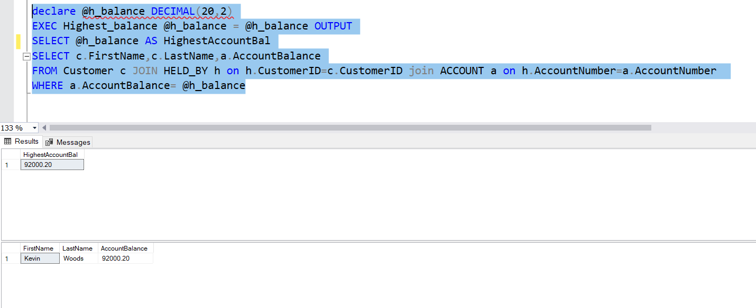
------Procedure to fetch the highest account balance
CREATE PROCEDURE Highest_balance
(
@h_balance DECIMAL(20,2) OUTPUT
) AS
BEGIN
SELECT @h_balance = Max(a.AccountBalance) FROM ACCOUNT a;
END
declare @h_balance DECIMAL(20,2)
EXEC Highest_balance @h_balance = @h_balance OUTPUT
SELECT @h_balance
SELECT c.FirstName,c.LastName,a.AccountBalance
FROM Customer c JOIN HELD_BY h on h.CustomerID=c.CustomerID join ACCOUNT a on h.AccountNumber=a.AccountNumber
WHERE a.AccountBalance= @h_balance

Slide 22
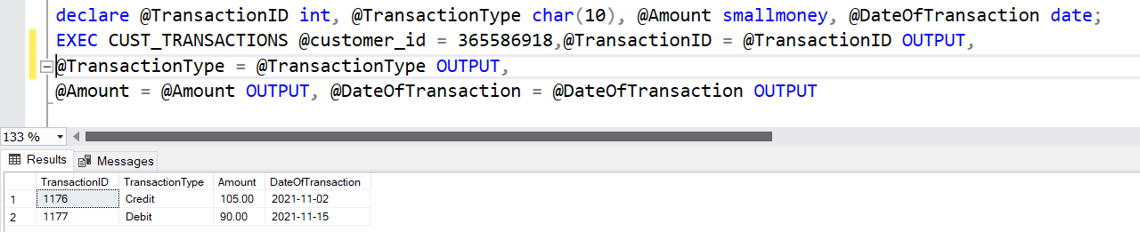
--------------Procedure to obtain the transactions for a particular customer ID
CREATE PROCEDURE CUST_TRANSACTIONS(
@customer_id int,
@TransactionID int OUTPUT,
@TransactionType char(10) OUTPUT,
@Amount smallmoney OUTPUT,
@DateOfTransaction date OUTPUT
)AS
BEGIN
DECLARE @StartDate DATETIME, @EndDate DATETIME;
SET @StartDate = dateadd(mm, -1, getdate())
SET @StartDate = dateadd(dd, datepart(dd, getdate())*-1, @StartDate)
SET @EndDate = dateadd(mm, 1, @StartDate)
SELECT t.TransactionID,t.TransactionType,t.Amount,t.DateOfTransaction
FROM Customer c JOIN HELD_BY h ON h.CustomerID=c.CustomerID JOIN ACCOUNT a ON a.AccountNumber=h.AccountNumber JOIN [TRANSACTION] t ON a.AccountNumber = t.AccountNumber
where c.CustomerID = @customer_id AND t.DateOfTransaction Between @StartDate and @EndDate
END;

Slide 23
--------------------------------Debit Credit transaction procedure
CREATE PROCEDURE Balance_Update
(@Amount_Update DECIMAL (20,2),
@AccountNumber int,
@UpdateType varchar(20)
)AS
IF @UpdateType='credit'
BEGIN
UPDATE account
SET accountbalance = accountbalance+ @Amount_Update
WHERE AccountNumber = @AccountNumber;
END
IF @UpdateType='debit'
BEGIN
UPDATE account
SET accountbalance = accountbalance - @Amount_Update
WHERE AccountNumber = @AccountNumber;
END

Slide 24
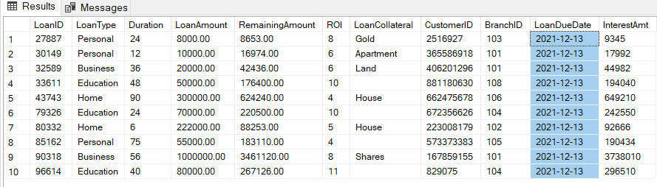
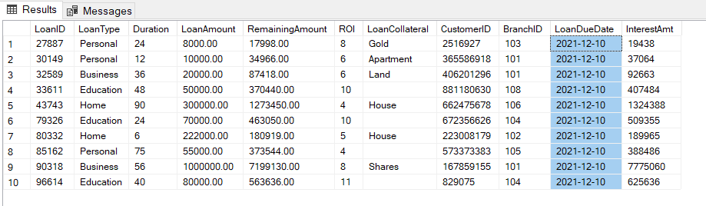
TRIGGERS
--Trigger to Update Loan Amount upon change in Loan Due Date
CREATE TRIGGER LoanAmountChange
ON LOAN
FOR UPDATE
AS
BEGIN
IF UPDATE(RemainingAmount) -- only interested in specific change
begin
UPDATE LOAN SET interestAmt = RemainingAmount*(ROI/100)
end
END

Slide 25
DASHBOARDS & LAYOUT

Slide 26
INDIVUDAL CONTRIBUTION

Slide 27
THANK YOU NOTE

